Slide 1
PERFORMING ARTS
DANCE

Slide 2
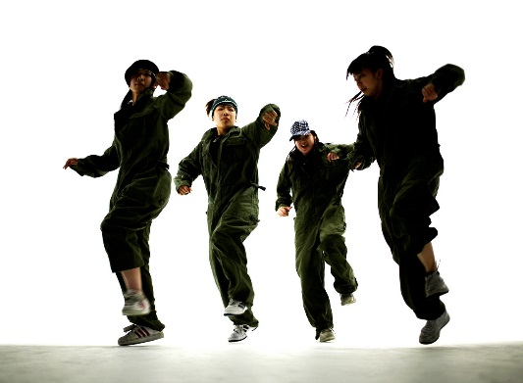
LEARNING OBJECTIVE
Recap to dance- understand the expectations of you in the studio
What are the 5 basic actions and how can we use them?
What is an EFFECTIVE warm up?

Slide 3
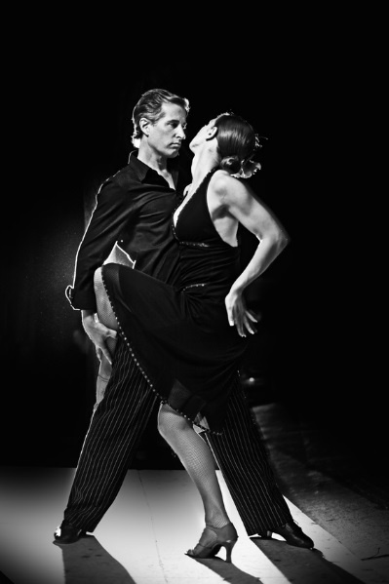
SUCCESS CRITERIA
Step 3
Can focus in the warm and identify some pulse raisers.
Can reproduce the taught routine with a few errors.
Step 4
Will focus and put effort in throughout the lessons and be able to identify the 3 sections of the warm up.
Will perform the routine with energy and focus.
Step 5.
Will concentrate and perform to the best of their ability throughout the lesson and work hard to warm up effectively.
Will perform with focus and accuracy of movement and always be keen to improve.
Step 6
Will be a role model to the group, work hard at all times and be proactive in asking and answering questions.
Will take a leadership role when rehearsing and help others to perform the routine.

Slide 4

FIZZ BUZZ
YOU HAVE TO JUMP FOR FIZZ AND SPIN FOR BUZZ
All pupils stand in a circle in the room. Go round the circle counting from one upwards, in number order. If a pupil says a multiple of 3 they JUMP and if they say a multiple of 5 they say SPIN. If they say a multiple of 3 and its also a multiple of 5 then they say JUMP AND SPIN at the same time.
Skills Required
Listening to others
Knowing your timetables
Thinking quickly
Concentrating
BE AWARE OF YOUR SPACE!

Slide 5
Different dance styles?
How many can you think of? In groups discuss the different styles and then share with the group
As a class choose 3 styles to research on YOU TUBE

Slide 6
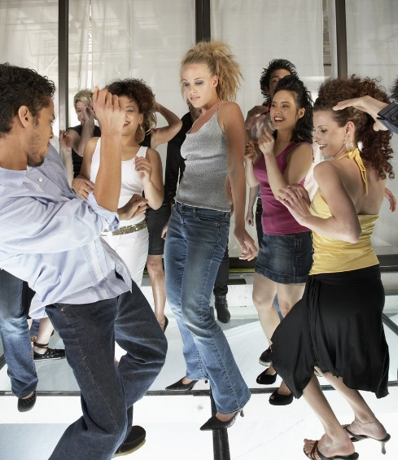
KEY WORDS
ACTION-WHAT
DYNAMIC-HOW
SPACE-WHERE
RELATIONSHIPS-WHO
RHYTHM-TIMING
FOCUS

Slide 7
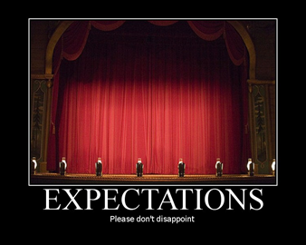

EXPECTATIONS
BE RESPECTFUL OF OTHERS IN THE CLASS.
TRY YOUR HARDEST AT ALL TIMES.
LISTEN TO FEEDBACK AND USE THIS CONSTRUCTIVELY TO IMPROVE YOUR PERFORMANCE.
LISTEN TO THE TEACHER AT ALL TIMES.
BE ABLE TO WORK AS A GROUP AND INDEPENDENTLY.
BE CREATIVE.
USE THE STAGE EFFECTIVELY.
LISTEN TO YOUR PEERS IDEAS

Slide 8

WARM UP-why do we warm up?
A warm up has 3 sections-
Pulser raiser,
Co-ordination
stretch.
CLASS DISCUSSION:Can you think of any exercises that would be good for each section?
Why do we warm up?
SOCKS OFF, HAIR UP, LINES OF 5, FEET IN PARALLEL
LETS GO!

Slide 9

TASK.
Turn to the person next to you and identify as many pulse raisers, co-ordination and stretches from the warm up you just completed.
2 MINUTE TASK
Create 3 Pulse raisers.
Share with the group.

Slide 10
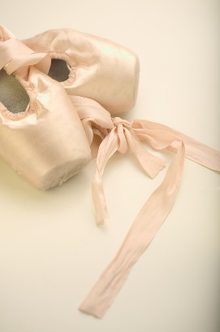
5 BASIC ACTIONS
The 5 basic actions are
Jump
Hop
Travel
Stillness/gesture
Turn/rotate
HOW CAN WE USE THESE IN A DANCE?

Slide 11
PLENARY
What have you learnt today?
Each corner of the room is a level. Go to the corner you think you are at and be ready to explain why and how you could improve.

Slide 12
Extension task
Begin new dance phrase.

